Slide 1
VISG Workshop
25 October 2012 Genome-wide expression analysis
Part I: basic analysis of RNA-seq data Mik Black, University of Otago
Marcus Davy, Plant and Food Research

Slide 2
Overview
Introduction:
Summary of NGS technologies
Data formats and quality assessment
Alignment
Tools and formats
Visualization
Basic RNA-seq analysis

Slide 3
Gene expression
Occurs when DNA is transcribed into RNA.
Each eukaryotic cell contains a nucleus with 5,000-60,000 protein coding genes.
At any time, only a subset expressed.
Fundamental to understanding function
Used to address variety of biological questions:
Normal versus diseased tissue.
Cell lines with or without drug treatment.

Slide 4
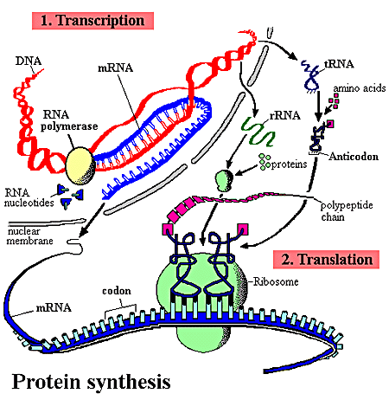
Central Dogma of Molecular Biology
DNA
mRNA
Protein

Slide 5
Measuring gene expression
One gene at a time approaches.
Northern blotting
Quantitative Real-time PCR
High throughput technologies
Microarrays
RNA sequencing (RNA-seq)

Slide 6
Beyond microarrays: RNA-seq
While microarrays revolutionized the study of gene expression, the hybridization-based approach has its limitations.
Knowledge of genome needed (probe generation)
Cross-hybridization between probes
Inability to identify novel transcripts
Direct sequencing of RNA (RNA-seq) provides greatly increased scope for gene expression analysis.

Slide 7
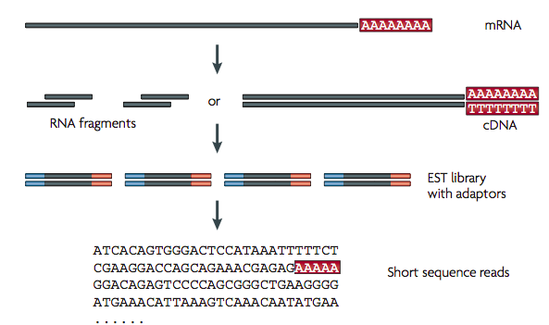
RNA-seq: generating sequence
Wang, Z., et al,. (2009). Nature Reviews Genetics, 10(1), 57–63.

Slide 8
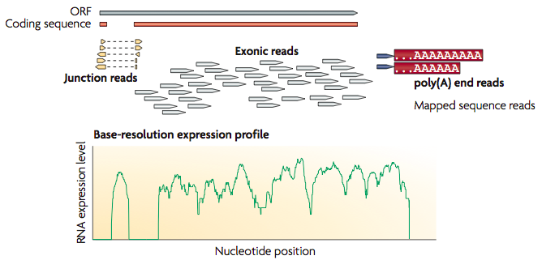
RNA-seq: gene expression data
Wang, Z., et al,. (2009). Nature Reviews Genetics, 10(1), 57–63.

Slide 9
Technology – NextGenSeq
Over the past few years, the “Next Generation” of sequencing technologies has emerged.
Three major players:
Roche: GS-FLX+, GS-Junior
Applied Biosystems: 5500 GA, Ion PGM/Proton
Illumina: HiSeq2000/2500, MiSeq

Slide 10

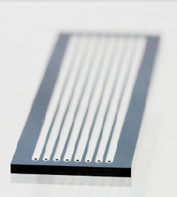
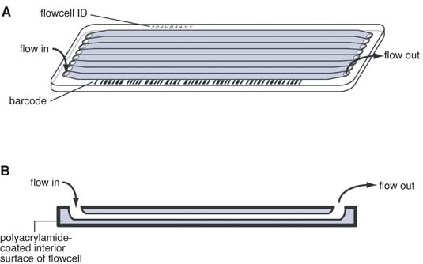
Illumina flow cell
www.illumina.com
Quail et al. Current protocols in human genetics (2009) vol. Chapter 18 pp. Unit 18.2

Slide 11
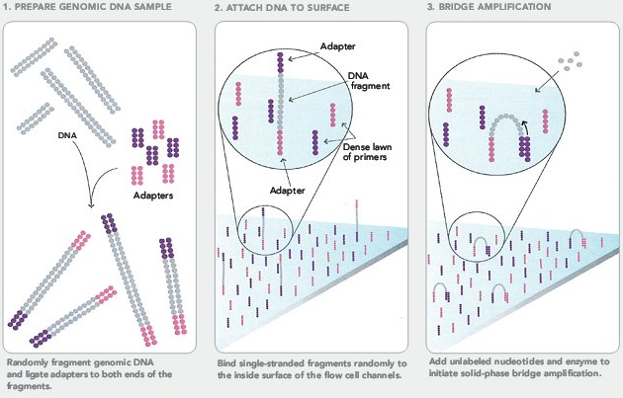
Illumina sequencing
www.illumina.com

Slide 12
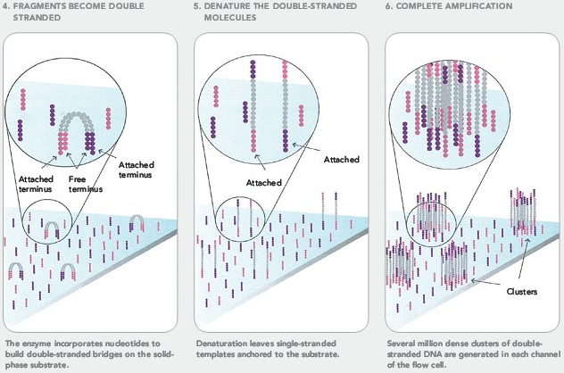
Illumina sequencing
www.illumina.com

Slide 13
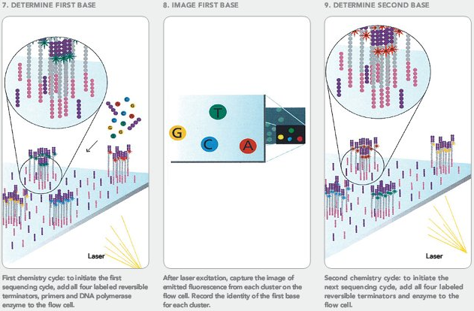
Illumina sequencing
www.illumina.com

Slide 14
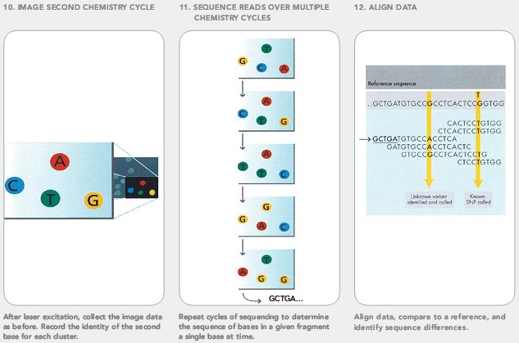
Illumina sequencing
www.illumina.com

Slide 15
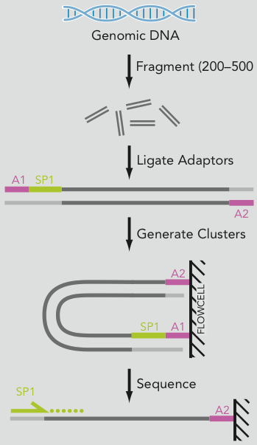
Single-end sequencing
Size select DNA fragments and add adapters (A1 and A2).
A1 also has sequencing primer (SP1) attached.
Sequencing occurs on A2 fragment.
http://www.illumina.com/documents/products/datasheets/datasheet_genomic_sequence.pdf

Slide 16
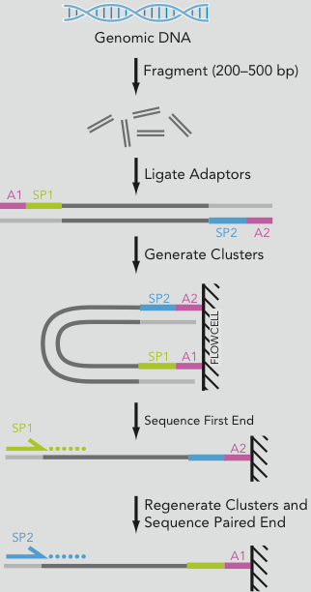
Paired-end sequencing
Size select DNA fragments and add adapters and primers(A1+SP1 and A2+SP2).
Sequencing occurs on both fragments.
The distance between the sequenced read pair is called the “insert size”.
http://www.illumina.com/documents/products/datasheets/datasheet_genomic_sequence.pdf

Slide 17
Mate-pair sequencing
Label ends of long DNA fragment.
Circularize and fragment again.
Enrich (amplify) the biotin labeled fragments.
Proceed as for paired-end reads (basically “mate-pairs” are paired ends with a long insert size).
http://www.illumina.com/documents/products/datasheets/datasheet_genomic_sequence.pdf

Slide 18
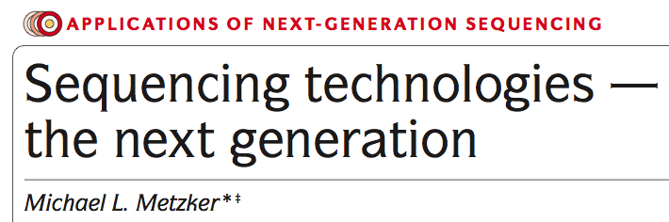

Slide 19
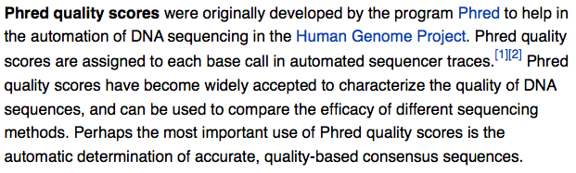
Assessing quality: phred scores
http://en.wikipedia.org/wiki/Phred_quality_score
P=error probability of a
given base call
Ewing B, Green P. (1998): Base-calling of automated sequencer traces using phred. II. Error probabilities. Genome Res. 8(3):186-194.

Slide 20
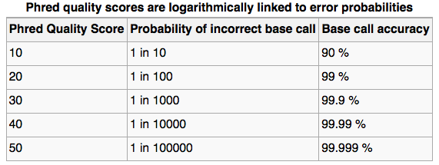
Assessing quality: phred scores
http://en.wikipedia.org/wiki/Phred_quality_score
Can use ASCII to represent quality scores by adding 33 to the phred score (although Illumina scores use an offset of 64) and converting to ASCII.
Illumina quality score of 40 becomes 40+64=104: “h”

Slide 21
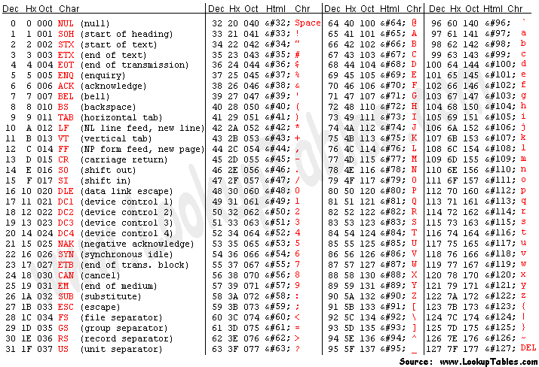

Slide 22
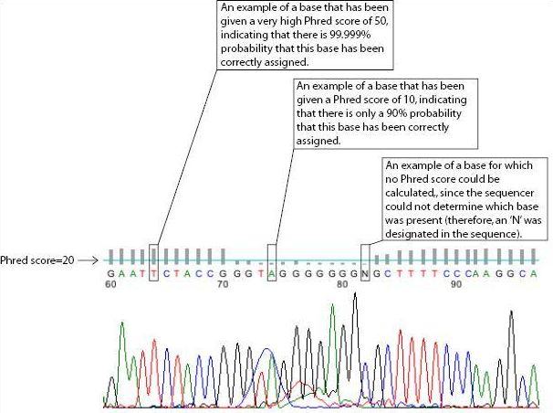
http://en.wikipedia.org/wiki/Phred_quality_score

Slide 23
Data format
The FASTQ format allows the storage of both sequence and quality information for each read.
This is a compact text-based format that has become the de facto standard for storing data from next generation sequencing experiments.

Slide 24
Fastq format
@HWUSI-EAS582_157:6:1:1:1501/1
NCACAGACACACACGAACACACAAAGACATGCCCATATGAAGAT
+
%.7786867:778556858746575058873/347777476035
@HWUSI-EAS582_157:6:1:1:1606/1
NCTGGCACCTTGATTTTGGACTTCCCAGCCTCCAGAACTGTGAG
+
%1948988888798988366898888648998788898888588
@HWUSI-EAS582_157:6:1:1:453/1
NCTGCTTGCACCCCTGAAGTCACTGATCACATTTCAGGGTCACC
+
%/868998988888867668888986644788988413488885
@HWUSI-EAS582_157:6:1:1:1844/1
NGATTGACATTGGCAAAGAGGACAACTGATTGCAAACTTCACAC
+
%-7;:::::;86499;75574586::635:62687666887879
@HWUSI-EAS582_157:6:1:1:1707/1
NAGGCTCAGGCGCACGGCCTACATCGTCGCTGTCGGCCAAGGGG
+

Slide 25
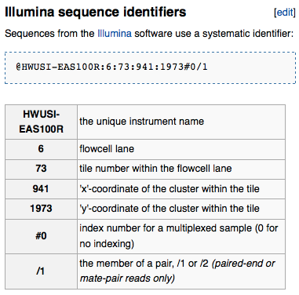
FASTQ format
@HWUSI-EAS582_157:6:1:1:1501/1
NCACAGACACACACGAACACACAAAGACATGCCCATATGAAGAT
+
%.7786867:778556858746575058873/347777476035
@HWUSI-EAS582_157:6:1:1:1606/1
NCTGGCACCTTGATTTTGGACTTCCCAGCCTCCAGAACTGTGAG
+
%1948988888798988366898888648998788898888588
@HWUSI-EAS582_157:6:1:1:453/1
NCTGCTTGCACCCCTGAAGTCACTGATCACATTTCAGGGTCACC
+
%/868998988888867668888986644788988413488885
@HWUSI-EAS582_157:6:1:1:1844/1
NGATTGACATTGGCAAAGAGGACAACTGATTGCAAACTTCACAC
+
%-7;:::::;86499;75574586::635:62687666887879
@HWUSI-EAS582_157:6:1:1:1707/1
NAGGCTCAGGCGCACGGCCTACATCGTCGCTGTCGGCCAAGGGG
+
“Read” (sequence)
Quality scores (phred-33)
http://en.wikipedia.org/wiki/FASTQ_format

Slide 26
FastQC
Simple java-based tool for quality assessment of next generation sequencing data.
Takes FASTQ file as input and generates multiple QC plots.
No ability to customize or interact with plots.

Slide 27
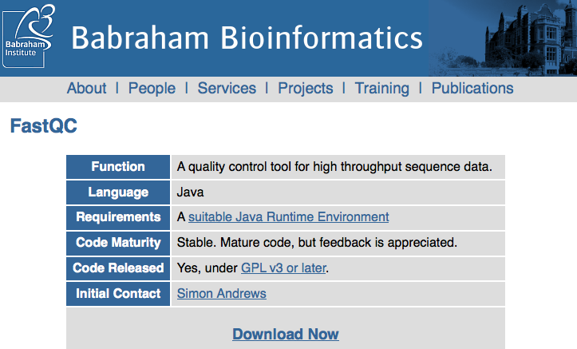
FastQC
http://www.bioinformatics.bbsrc.ac.uk/projects/fastqc/

Slide 28
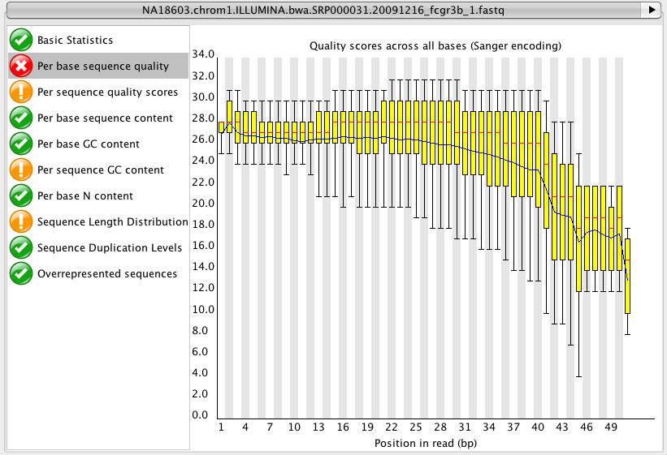
FastQC

Slide 29
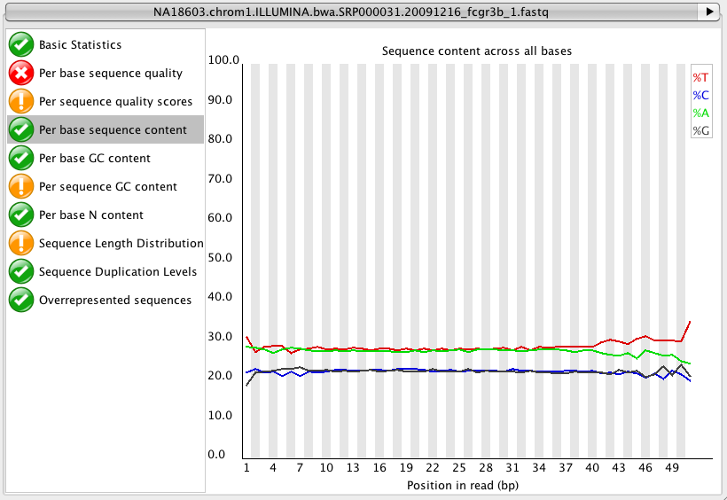
FastQC

Slide 30
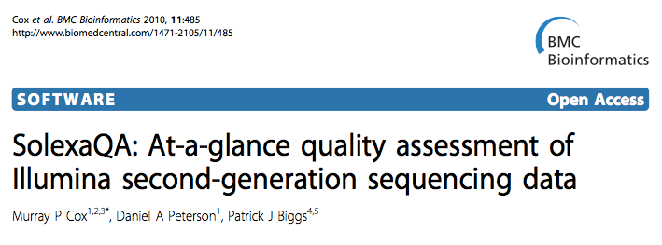
SolexaQA

Slide 31
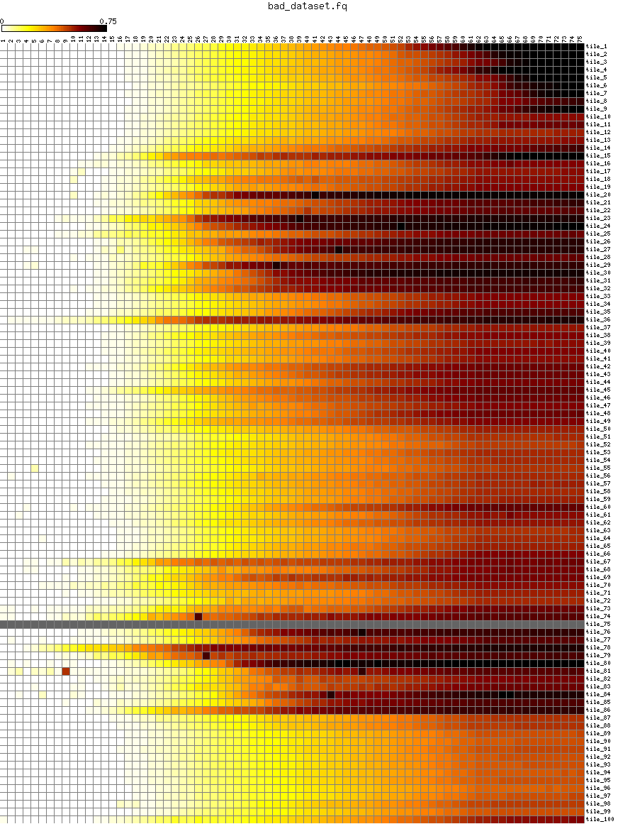
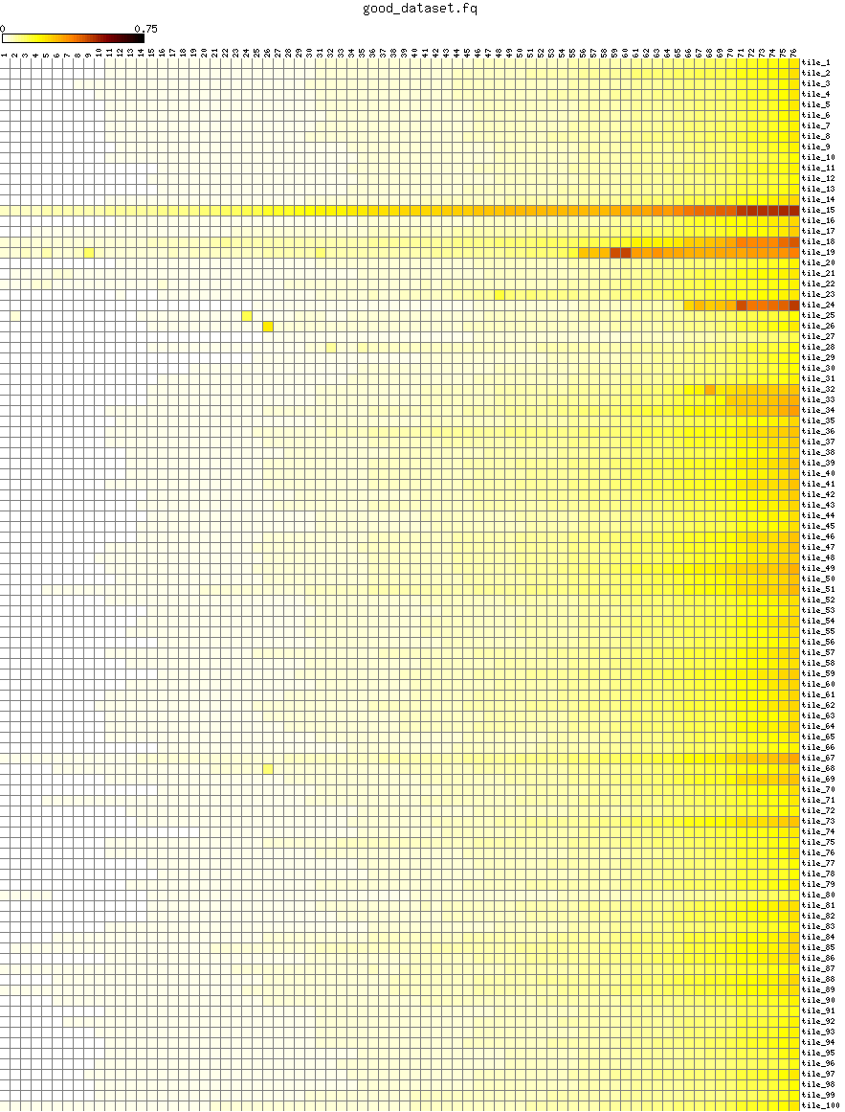
Bad data
Good data
http://sourceforge.net/projects/solexaqa/files/examples/

Slide 32
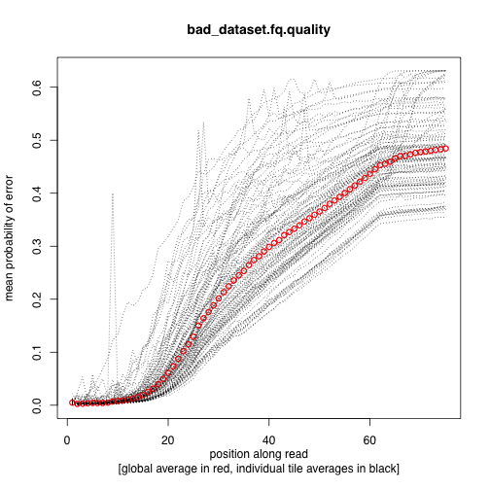
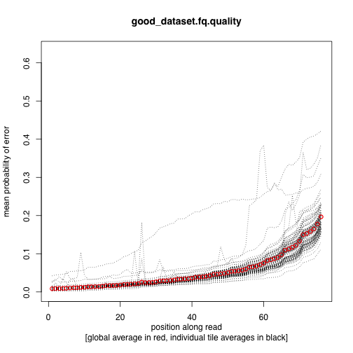
Quality by cycle (position in read)

Slide 33
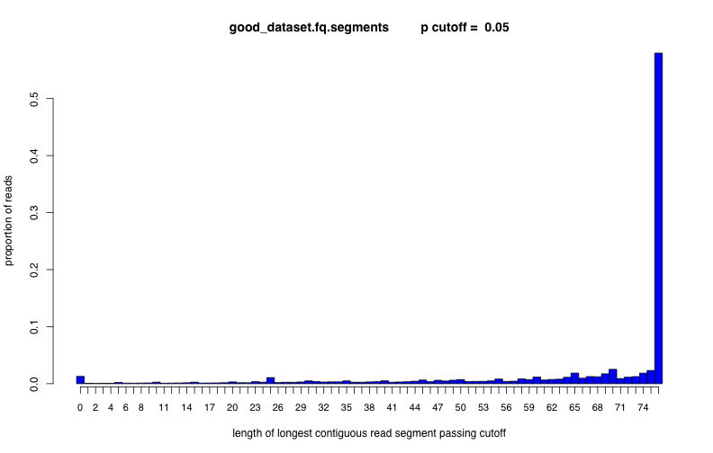
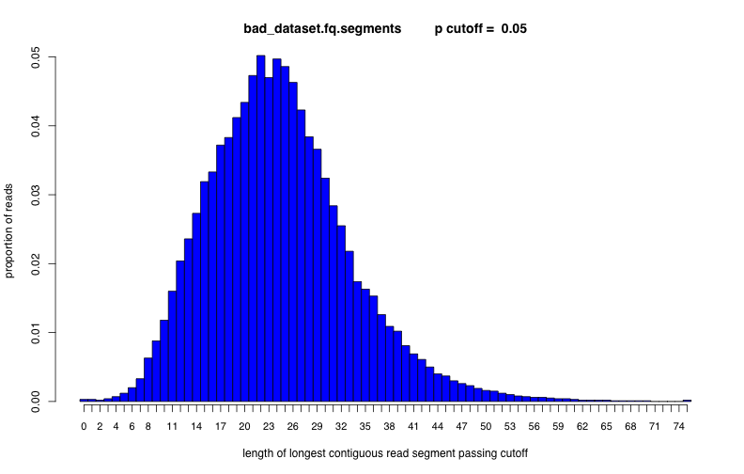

Slide 34

Galaxy provides a web-based application for the analysis of sequence data
Includes tools for the analysis and manipulation of NGS data
Simple and extensible interface

Slide 35
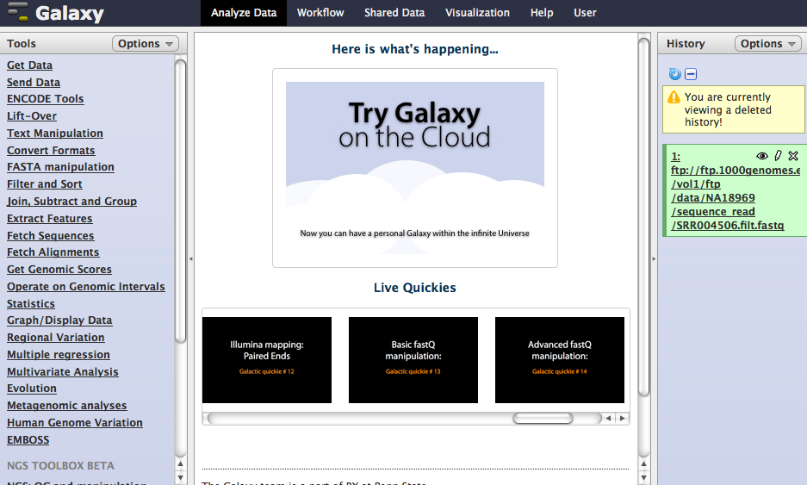
http://main.g2.bx.psu.edu/

Slide 36
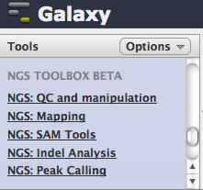
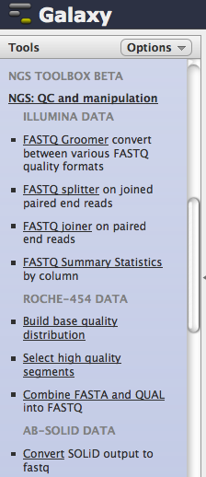
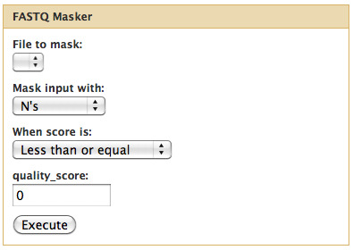

Slide 37
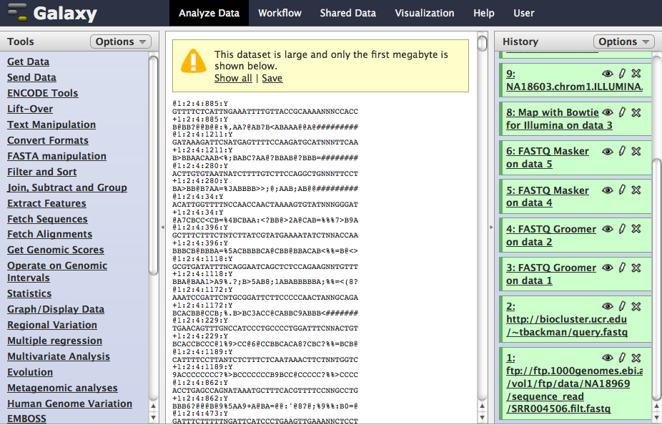
Analysis modules
Data browser
History

Slide 38
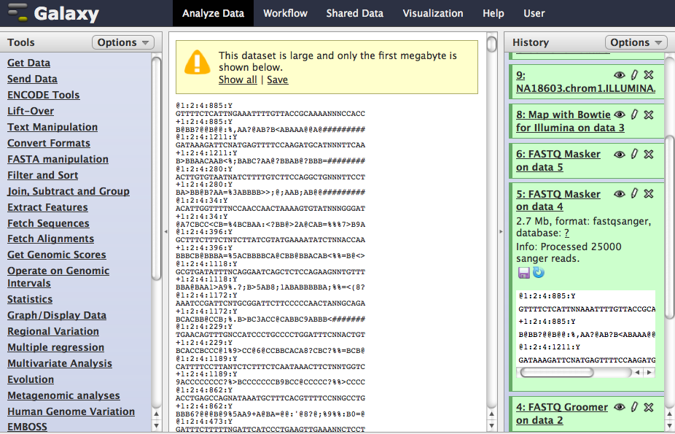
Preview

Slide 39
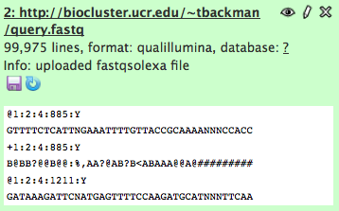
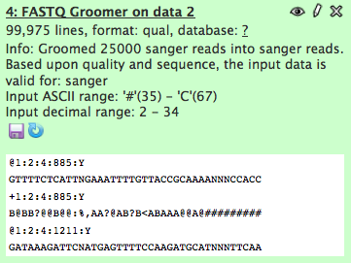
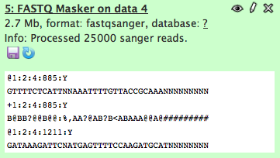
Import fastq data
“Groom” imported data for use in other modules
Mask low quality bases with N’s

Slide 40
Alignment
If a “reference” genome exists for the organism you are sequencing, reads can be “aligned” to the reference.
This involves finding the place in the reference genome that each read matches to.
Due to high sequence similarity within members of the same species, most reads should map to the reference.

Slide 41
Tools for generating alignments
There are MANY software packages available for aligning data from next generation sequencing experiments.
Two of the most popular are:
BWA: http://bio-bwa.sourceforge.net
Bowtie: http://bowtie-bio.sourceforge.net
Both utilize the “Burrows-Wheeler Transform.”

Slide 42
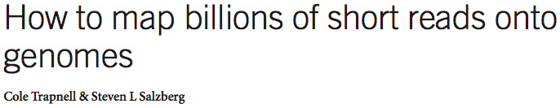
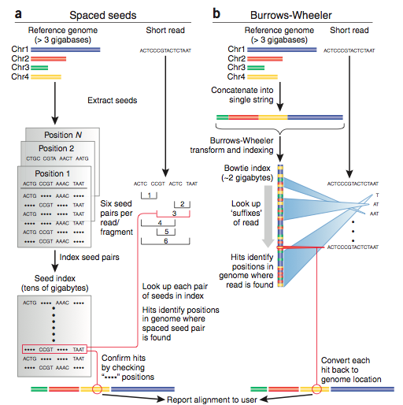

Slide 43
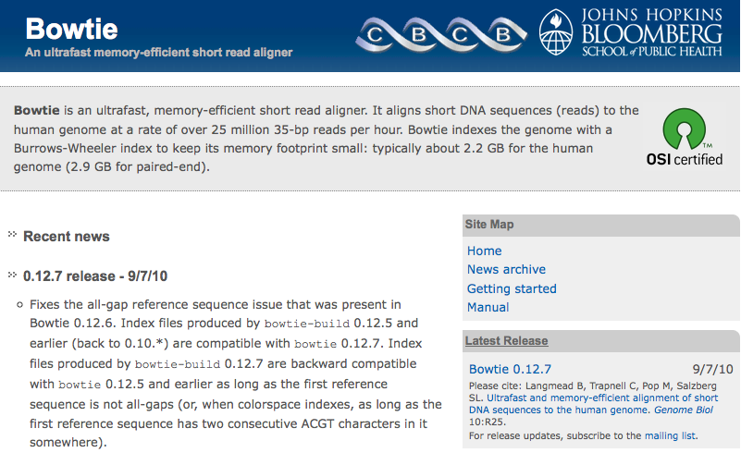
http://bowtie-bio.sourceforge.net/index.shtml

Slide 44
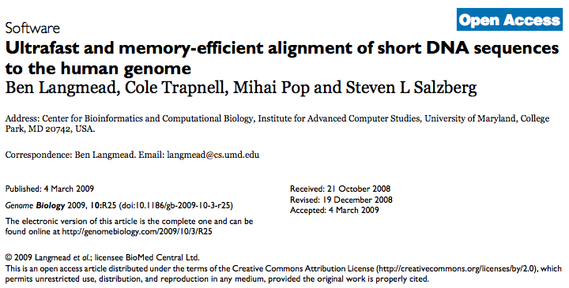
http://bowtie-bio.sourceforge.net/index.shtml

Slide 45

http://bio-bwa.sourceforge.net/

Slide 46
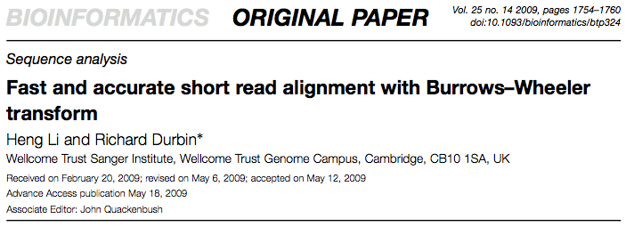
http://bio-bwa.sourceforge.net/

Slide 47
Alignment formats
SAM (Sequence Alignment/Map) format has become the de facto standard for storing alignment data.
BAM is a binary version of SAM allowing more efficient storage.

Slide 48
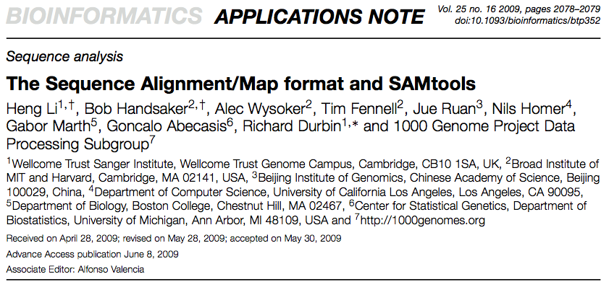

Slide 49
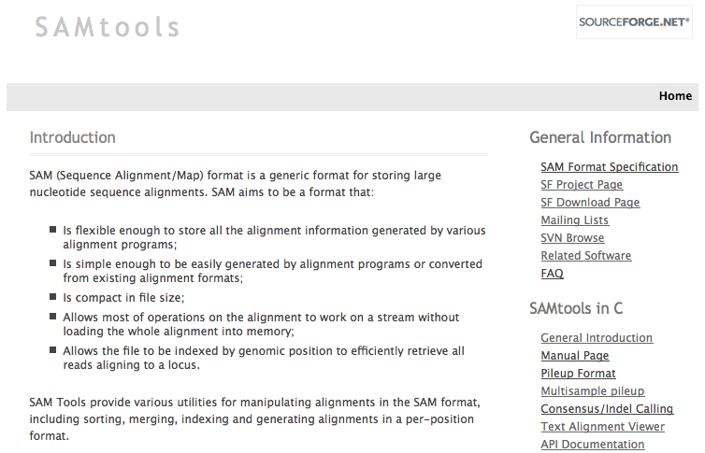
http://samtools.sourceforge.net/

Slide 50
SAMtools
http://samtools.sourceforge.net/
SAMtools provides a command line interface for manipulation of SAM/BAM formatted data.
Open source and multi-platform (R package available: Rsamtools).
Able to:
Extract reads from specific genomic region
Operate on remote files
Much more….

Slide 51
SAM format
ERR005646.11088674 147 1 161099954 60 54M = 161099742 -266 TTTTCTGAACAGGGATGATATTTGTAATTTCATAGAATTAAGAGATATCTGACT 89=<;@>EECFCBBFFCAEFBGB=FFFC?@AB@G=FFB@CABABA?A@<>>=;= XT:A:U NM:i:0 SM:i:37 AM:i:37 X0:i:1 X1:i:0 XM:i:0 XO:i:0 XG:i:0 MD:Z:54 RG:Z:ERR005646 OQ:Z:D?FFEEEFFFFFFFFFFEFFDFECFFFE;EEEEFCFFEEEEFEFECEEC=E;EF
ERR005646.5518024 147 1 161099956 60 54M = 161099847 -163 TTCTGAACAGGGATGATATTTGTAATTTCATAGAATTAAGAGATATCTGACTCT :68=<A@@A???AB?A>ABBB>@CABCAAA>B@BAB@BA@A@A@A@=A=A=>;< XT:A:U NM:i:0 SM:i:37 AM:i:37 X0:i:1 X1:i:0 XM:i:0 XO:i:0 XG:i:0 MD:Z:54 RG:Z:ERR005646 OQ:Z:ECEEEEEEEEDEEEEE>EEEEEEEEEEEEE@EEEEEBEEEEEEEEECCCBEEEE

Slide 52
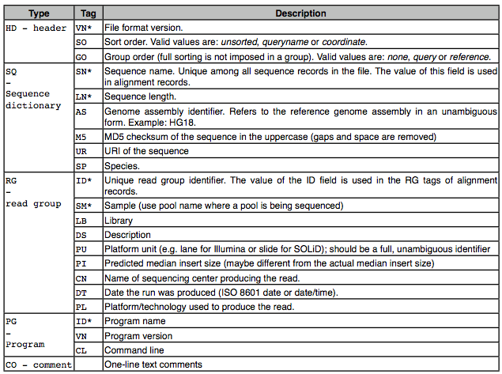
SAM format
http://samtools.sourceforge.net/

Slide 53
Alignment using BWA and SAMtools
# download a test reference genome (TAIR9 Chromosome 1)
wget http://biocluster.ucr.edu/~tbackman/genome.fasta
# download some test Illumina reads from Arabidopsis
wget http://biocluster.ucr.edu/~tbackman/query.fastq
# index reference genome
bwa index -a is genome.fasta
# perform alignment
bwa aln genome.fasta query.fastq > output.sai
# generate SAM formatted alignment output
bwa samse -n -1 genome.fasta output.sai query.fastq > output.sam
# use samtools to generate bam file
samtools view -bS -o output.bam output.sam
# sort entries in bam file
samtools sort output.bam output.sorted
# index reads in bam file
samtools index output.sorted.bam
Code from: http://manuals.bioinformatics.ucr.edu/home/ht-seq

Slide 54
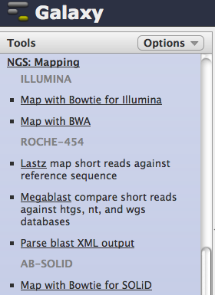
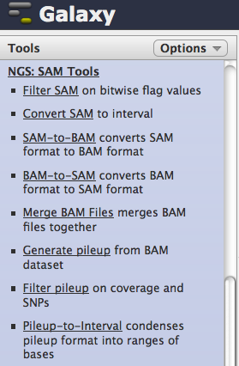
Alignment using Galaxy

Slide 55
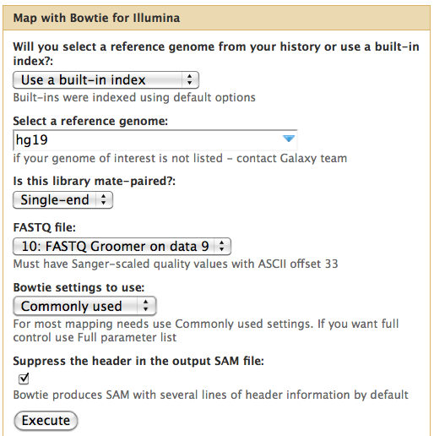

Slide 56
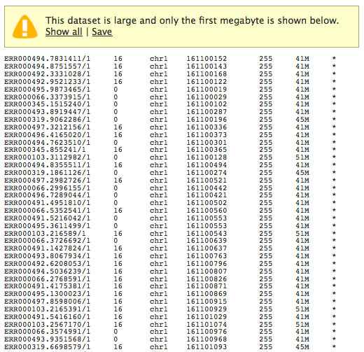

Slide 57
More advanced: the “Tuxedo Suite”
http://www.cbcb.umd.edu/software
The Tuxedo Suite consists of:
Bowtie: alignment to reference genome
Tophat: splice-aware alignment for RNA-seq data
Cufflinks: transcript-based analysis of expression levels
CumbRbund: R tool for visualization of differential expression analysis
Available in GenePattern and Galaxy

Slide 58
Visualization
Many (many!) genome browsers available:
UCSC Genome Browser
Ensembl
Gbrowse
1000 Genomes Browser
Integrative Genomics Viewer (IGV)
…

Slide 59
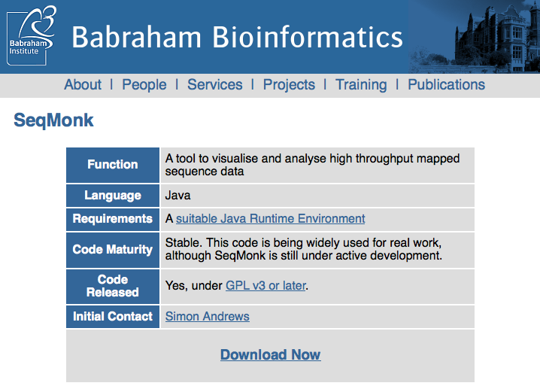
SeqMonk
http://www.bioinformatics.bbsrc.ac.uk/projects/seqmonk/

Slide 60
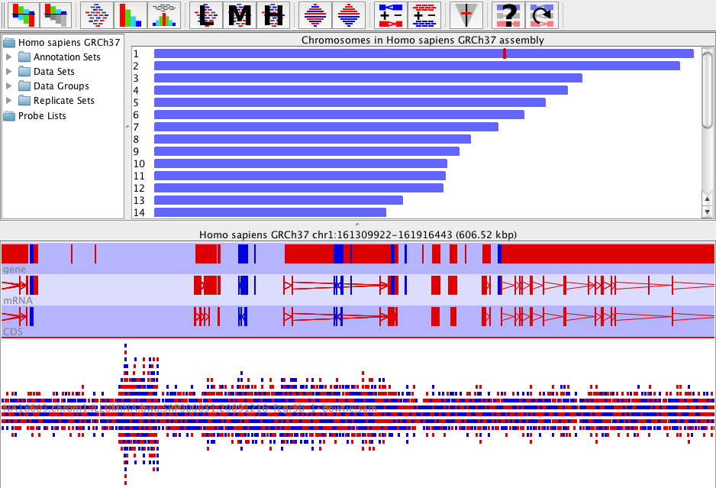

Slide 61
Quantifying expression
Based on the “depth” of reads aligned to the genome, an assessment of gene (or exon) expression level can be made for each transcript of interest.
Statistical methods can then be used to detect transcripts undergoing significant changes in expression between experimental conditions.

Slide 62
Transcript length bias
Often standardize raw counts of reads per transcript, by transcript length to avoid bias.
RPKM = “Reads per kilobase of exon model per million mapped reads” (Mortazavi et al, Nature Methods, 2008).
RPKM normalizes “for RNA length and for the total read number in the measurement”.

Slide 63
Notes on RPKM
For paired-end data, FPKM, is often used (e.g., by Cufflinks) to count Fragments rather than Reads.
A number of authors have pointed out problems with RPKM and FPKM normalization.
Differences in counts distribution across samples
Per-gene GC content detection differences
Cross-sample GC content differences
Increasingly sophisticated algorithms are being developed to deal with these issues.

Slide 64
RNA-seq walkthrough
View aligned data in SeqMonk
Generate counts for each gene
Export and perform differential expression analysis via limma in GenePattern

Slide 65


Data obtained from yeast RNA-seq experiment
Wild-type versus RNA degradation mutants
Subset of data (chromosome 1)
Six samples (3 WT / 3 MT)

Slide 66


Slide 67


Slide 68


Slide 69


Slide 70


Slide 71


Slide 72


Slide 73


Slide 74


Slide 75


Slide 76


Slide 77


Slide 78


Slide 79


Slide 80


Slide 81


Slide 82



Slide 83


Slide 84
Data: logged RPKM values

Slide 85
What is our goal?
For each gene, we want to determine whether there is a significant difference in expression between the two yeast genotypes (wild-type and mutant): this is referred to as differential expression.
Question: if we see a difference, are we actually observing differential expression, or is it due to chance variation?

Slide 86
Fold changes
Differential expression is often reported as a fold change (e.g., between mutant and wild-type):
Often the log₂ scale is used:
Initially (for microarray data), genes with fold changes greater than 2 (log₂(2) = 1) or less than 1/2 (log₂(1/2) = −1) were considered to have undergone differential expression.

Slide 87
Detecting changes in expression
In order to determine whether a gene has undergone differential expression between two conditions (e.g., MT vs WT), multiple observations are generally required.
Assuming that we have multiple measurements for a gene under each condition, basic statistical methods can be used to answer this question.

Slide 88
Determining differential expression
In the yeast example, we are interested in detecting differences in gene expression between two cell lines, mutant (MT) and wild-type (WT).
We have three RNA-seq samples from each genotype (MT and WT).
The RNA-seq reads can be mapped to each gene in the yeast genome, and we can then generate logged RPKM data.
For gene k we have six RPKM observations, three from each genotype:
Treatment 1 (mutant): X_{k11} X_{k12} X_{k13}
Treatment 2 (wild-type): X_{k21} X_{k22} X_{k23}

Slide 89
Aside: why take logs?
Data on an “intensity” scale often have the following characteristics:
Minimum at zero
Highly right-skewed distribution
Taking logs reduces the skewness of the distribution, and places the measure of interest (fold-change) on the additive scale.
This allows standard statistical tests to be applied.

Slide 90
Determining differential expression
Assuming that there are no experimental effects present in the data, we conclude that any differences in RPKM values are the result of differences in expression level.
To test this, we can conduct a formal hypothesis test (for each gene) to determine whether the mean intensity changed between the mutant and wild-type samples.
Since most basic statistical tests are set up to provide answers on the additive scale, and fold changes are on the multiplicative scale, we generally take logs of the data:
Y_{kij} = log(X_{kij})

Slide 91
Hypothesis testing
In statistics, we think of our sample means as providing estimates of the underlying (true) population means for each gene, μ_{k1} and μ_{k2}.
For each gene, we want to test the following null hypothesis:
H_{0k} : μ_{k1} = μ_{k2}
against the alternative hypothesis:
H_{Ak} : μ_{k1} ≠ μ_{k2}
If we reject the null hypothesis for a particular gene, we think that gene is likely to be differentially expressed.

Slide 92
Hypothesis testing
In order to conduct the hypothesis test, we need a test statistic. The most simple approach is to utilize the test statistic of the standard t-test
where and are the sample means of the data, and is some appropriate measure of variability.
Various choices are possible for depending on the structure of the data.

Slide 93
Moderated t-statistic: limma
A popular approach to microarray analysis uses the following moderated test statistic:
where the SE term is now moderated based on the distribution of variances across all genes.
The advantage of this approach is that it reduces the effects of very small and very large variances when samples sizes are low.
This procedure uses an Empirical Bayes approach called shrinkage estimation to adjust the variances.

Slide 94
P-values
Once we have calculated a gene-specific test statistic, we can either use a t distribution, or resampling methods (e.g., randomization test) to calculate a p-value for each gene, p_{k}.
The p-value represents the probability of observing this (or a more extreme) result, if no differential expression occurred. (i.e., what is the chance we are just observing noise?)
We reject H_{0k} (i.e., say gene k is differentially expressed) if p_{k} is small.
Question: what does small mean?

Slide 95


(Partial) limma output

Slide 96
Limma output
There are some genes with TINY p-values and LARGE fold-changes.
Do they ALL have significantly altered expression between mutant and wild-type?

Slide 97
P-values
We have to decide how small a p-value needs to be for us to think that the difference we are observing cannot be explained solely by noise.
When we test a single hypothesis, it is common to fix a type I error rate of α= 0.05 or α = 0.01.
Type I error: reject null hypothesis when it is true (i.e., say a gene is differentially expressed when it really isn’t).
Type II error: fail to reject the null hypothesis when it is false (i.e., say a gene is not differentially expressed when it really is).

Slide 98
Type I errors
Using a type I error rate of α= 0.05 means that we are willing to make a type I error in 5% of our hypothesis tests (i.e., 5% of the time that the null hypothesis is true, we will say that it’s false).
So for every 20 hypothesis tests we perform, on average we expect 1 type I error.
What if we are performing 20,000 hypothesis tests?
1000 TYPE I ERRORS!

Slide 99
Adjusting the α level
Obviously using an α level of 0.05 (or even 0.01) is not suitable when testing large numbers of hypotheses.
To get around this problem we use Multiple Comparison Procedures (MCPs).
MCPs provide error rate control, allowing us to keep a lid on how many type I errors we make.

Slide 100
Family-wise error rate control
Control of the family-wise error rate (FWER) is very common in multiple testing problems.
MCPs which control the FWER guarantee that FWER≤α, where a “family-wise error” is defined to be the occurrence of a single type I error in the entire family (set) of hypotheses being tested.
For the RNA-seq experiment we test each gene for differential expression, so there are as many hypothesis tests as there are genes.
The Bonferroni and Holm procedures both provide control of the FWER.

Slide 101
What’s so great about FWER control?
Advantage: FWER controlling procedures provide a high level of certainty in your result. The null hypotheses rejected by these procedures are very unlikely to be true. i.e., all of the rejected null hypotheses are likely to be correct rejections.
Disadvantage: This level of control is very conservative - it is likely that some genes undergo differential expression, but their null hypotheses are not rejected. As the number of hypotheses being tested becomes very large, the significance threshold becomes extremely small.

Slide 102
What is the alternative?
Continue to control the FWER, but use a larger value?
Switch to a different error rate?
What other error rates exist? (not many...)

Slide 103
False Discovery Rate control
The False Discovery Rate was introduced by Benjamini and Hochberg (1995 - JRSS(B)).
Provides a less conservative approach to error rate control than FWER controlling procedures.
Greater power comes at the cost of an increased likelihood of type I errors.
Has become very popular in microarray analysis, plus astronomy, brain imaging, and genetics (all test large numbers of hypotheses).

Slide 104
Error rate control
FWER control is concerned with making sure that the probability of a single testing error is small.
FDR control in concerned with keeping the proportion of type I errors out of the total number of rejected hypotheses small.
This value can be anything from 0 to 1.

Slide 105
FDR control versus FWER control
FDR controlling procedures provide more error rate protection than not adjusting at all, but are a lot more likely to make type I errors than FWER controlling procedures.
The flip side is that FDR controlling methods are more likely to reject false null hypotheses (i.e., they achieve greater power).

Slide 106

Full limma output

Slide 107

Further down the list…

Slide 108

Even further down the list…

Slide 109
Significant genes
Number of genes declared significantly differentially expressed between MT and WT:
No p-value adjustment: 5535 genes
False Discovery Rate control: 5404
FWER control: 1012 genes
Given that there were only 7075 features (genes) in total, FWER control is perhaps the best approach here.

Slide 110
Visualizing differential expression
Volcano plots are often used to visual the limma output.
The log fold-change (x-axis) is plotted against the log odds of differential expression (y-axis, “B statistic” from limma output).
The name comes from the shape of the plot…

Slide 111

Volcano plots: yeast data

Slide 112

http://www.broadinstitute.org/cancer/software/genepattern/
Reich M, Liefeld T, Gould J, Lerner J, Tamayo P, Mesirov JP GenePattern 2.0 Nature Genetics 38 no. 5 (2006): pp500-501

Slide 113


Slide 114


Slide 115

http://genepattern.broad.mit.edu/gp/pages/login.jsf

Slide 116


Slide 117


Slide 118


Slide 119


Slide 120


Slide 121


Slide 122


http://www.bioconductor.org/packages/release/bioc/html/limma.html

Slide 123


Slide 124


Slide 125


Slide 126


